Slide 1
Analysis of Spotify Music Streaming
Saif Ahmed | Robert Englund | Melissa Peck | Zean zhang

Slide 2
Our Project Objectives
In the US, is there a seasonality to frequency of streaming the Top 200 songs and has streaming frequency been impacted by Covid?
Who are the most popular artists by # of streams and Top 200 in the US over the past year?
How many of the Top 200 songs are the same between the US and globally?

Slide 3
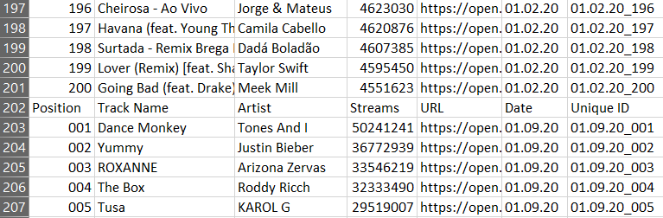
Cleaning up the Data
Combined all CSVs, added Date column as well as Unique ID column
Data was from 10/31/19 – 10/22/20, excel sorted starting 01/02/20
Minor cleaning like header row inconsistencies

Slide 4
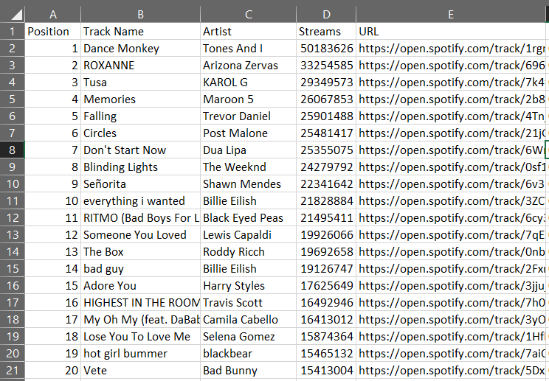
Finding the Data
Found Spotify and SoundCloud Developer tools
Discovered it was geared towards individual personal data
Tried several more APIs with the same results
Found publicly available Spotify Charts in CSV format
Only available per day and per week

Slide 5
Question:
In the US, is there a seasonality to frequency of streaming the Top 200 songs
Has streaming frequency of the Top 200 been impacted by COVID-19

Slide 6
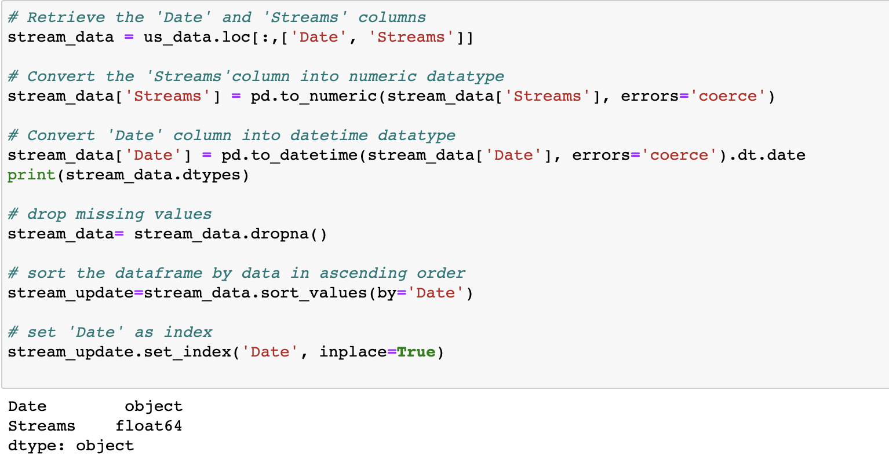
Data pre-processing->
We explore:
Frequency of streams by Date (11/2019 – 11/2020)
Change the datatype of Stream column to numerical
Sort data frame by ‘Date’

Slide 7
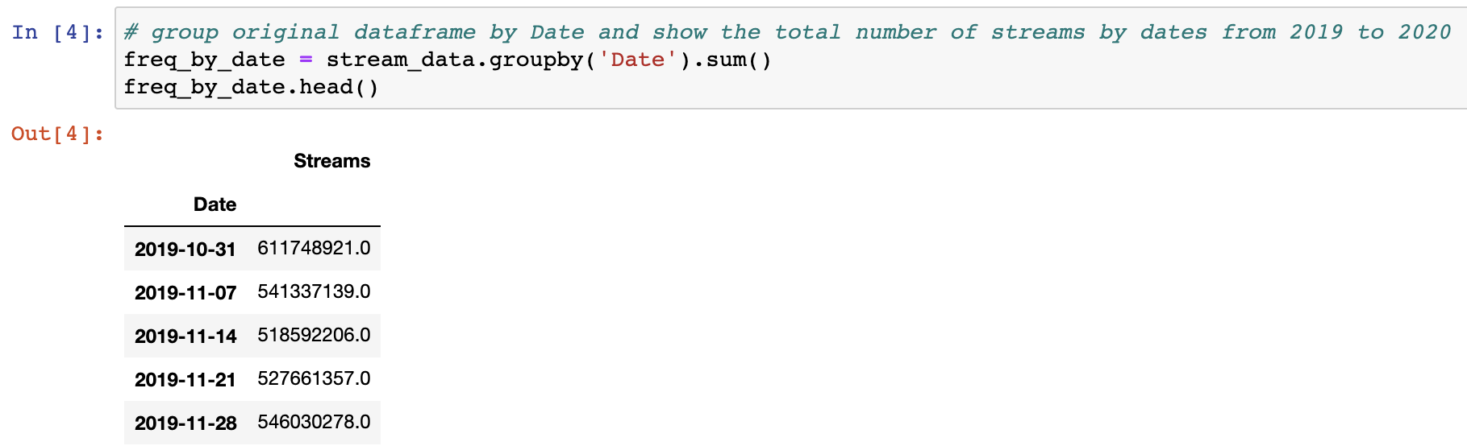
Analysis:
We explore:
Frequency of streams by Date (11/2019 – 11/2020)
Group by ‘Date’ and find total streams by each ‘Date’

Slide 8
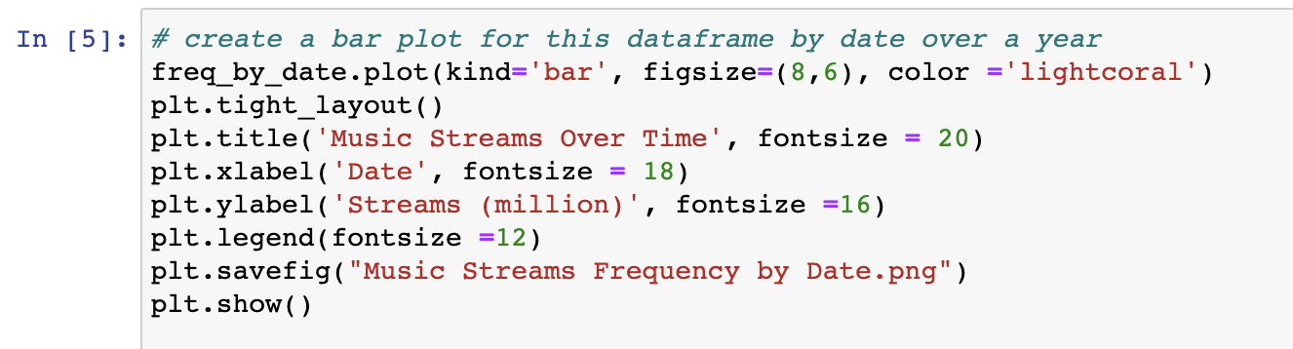
Analysis:
We explore:
Frequency of streams by Date (11/2019 – 11/2020)
Plot out the graph

Slide 9
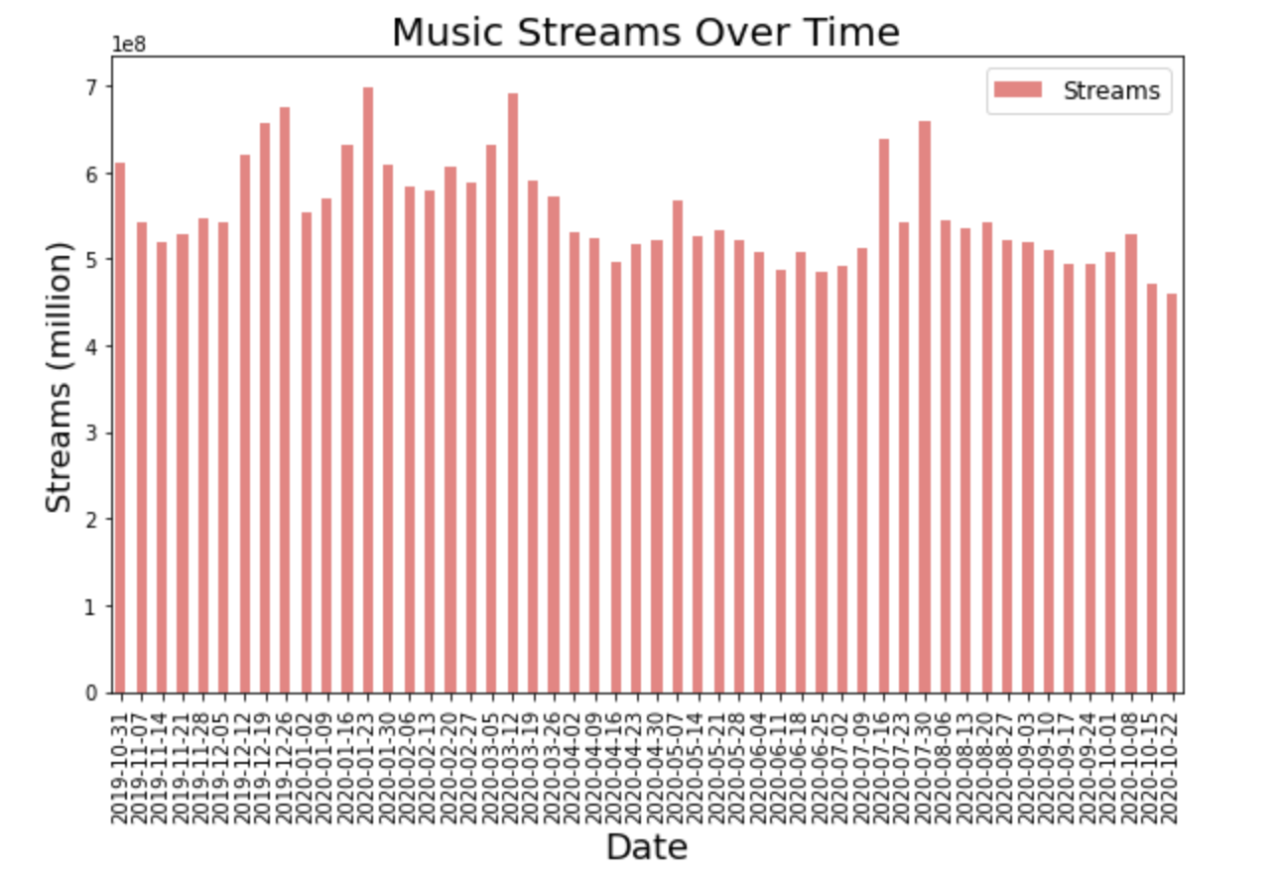
Graphs -> Frequency of streams by Date (11/2019 – 11/2020) ，in US

Slide 10
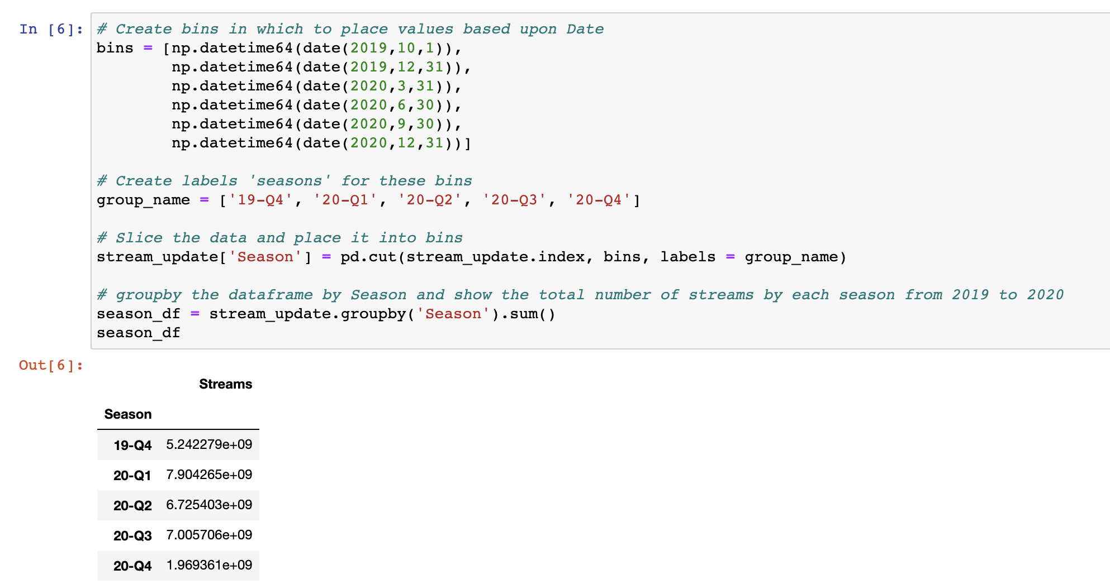
Analysis:
We explore:
Frequency of streams by Season(11/2019 – 11/2020)
Assign dates into different seasons
Group by ‘Season’ and find total streams by each ‘Season’

Slide 11
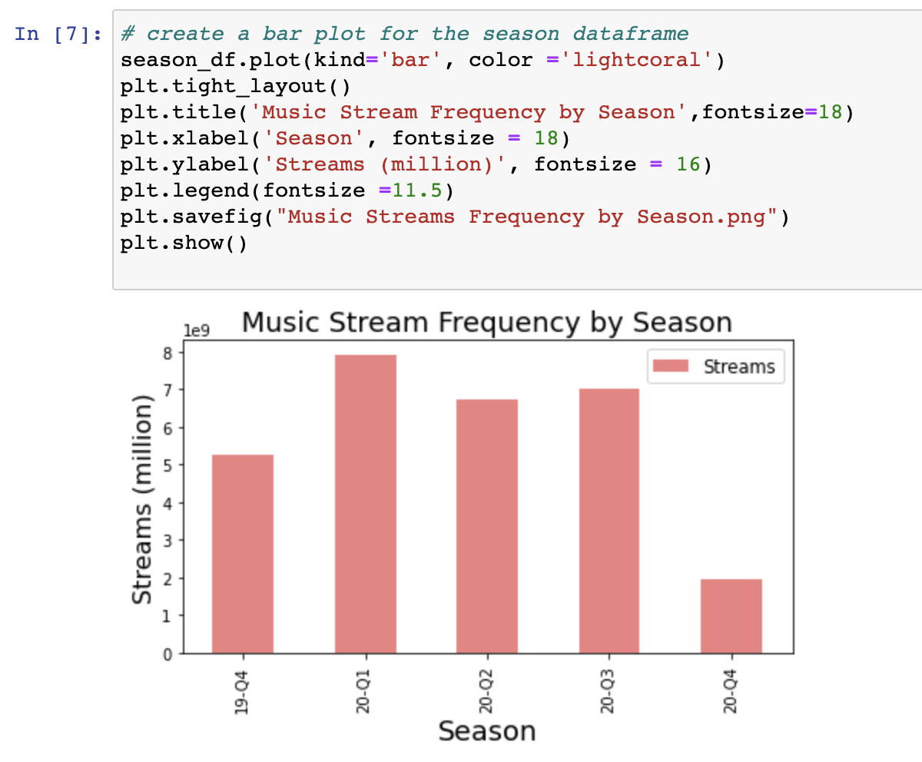
Graphs -> Frequency of streams by Season (11/2019 – 11/2020) ，in US

Slide 12
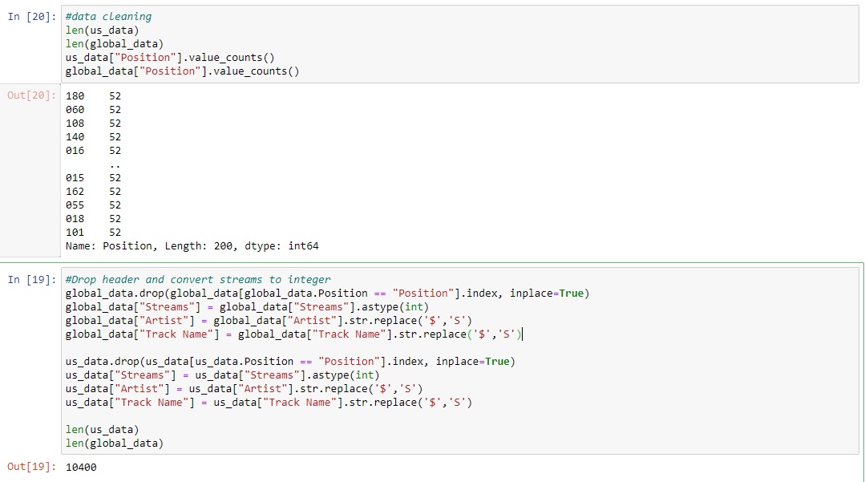
Step 1) Further data cleaning -> check length and counts drop header assign integer type to “streams”
Questions:
Most popular artists by: 1) number of appearances & 2) total streams in the Spotify Top 200 in the US and globally over the past year (11/2019 - 11/2020)?

Slide 13
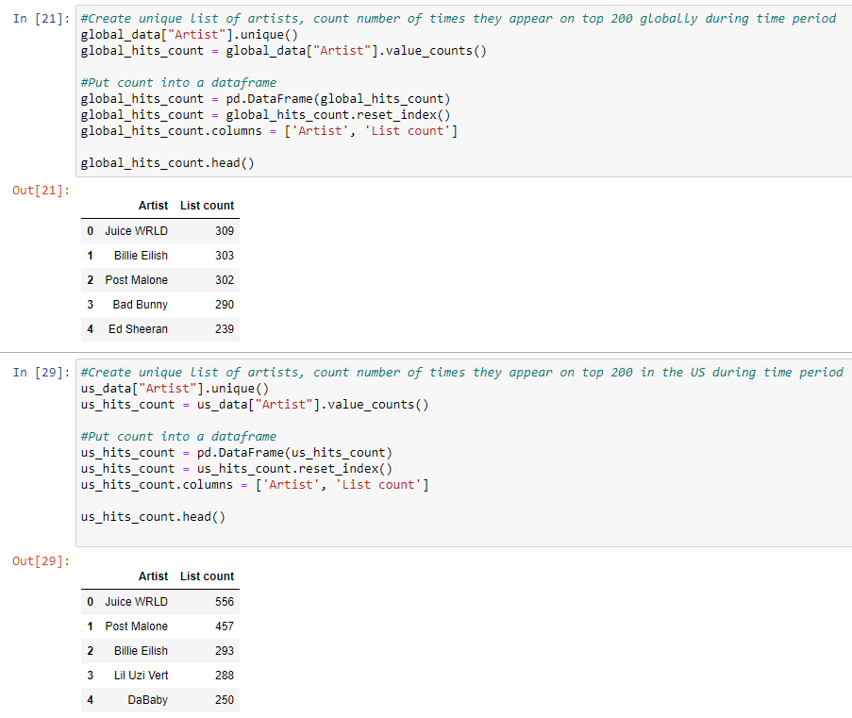
Analysis -> count the number of times each artist shows on the Top 200 during time period in US and globally put counts into a dataframe

Slide 14
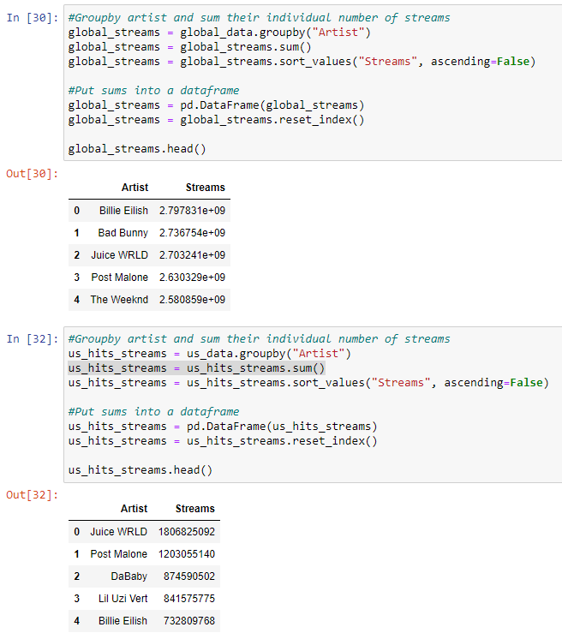
Analysis -> sum the total streams on the Top 200 by artist during time period in US and globally put stream info into a dataframe

Slide 15
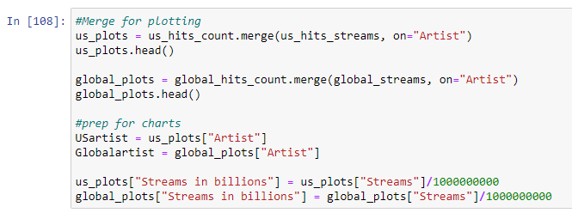
Preparing the data for graphs -> merging dataframes for comparison divide streams by 1 billion for cleaner graphs

Slide 16
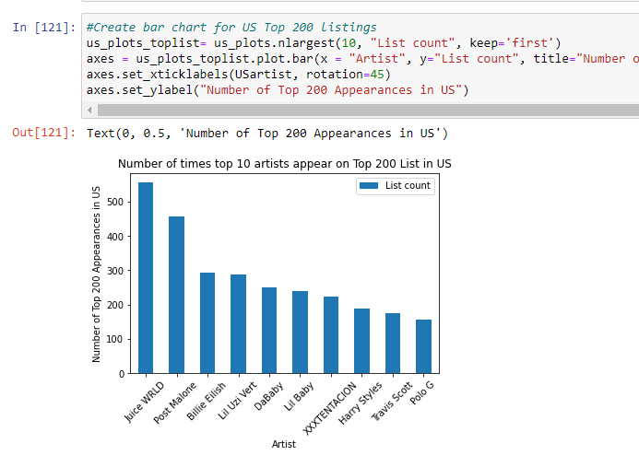
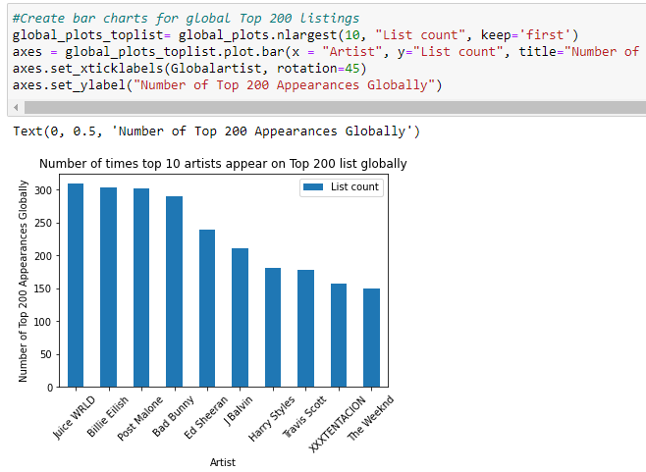
Graphs -> Top 10 artists with most appearances on Top 200 List, globally and in US
Most popular artists by: 1) number of appearances & 2) total streams in the Spotify Top 200 in the US and globally over the past year (11/2019 - 11/2020)?

Slide 17
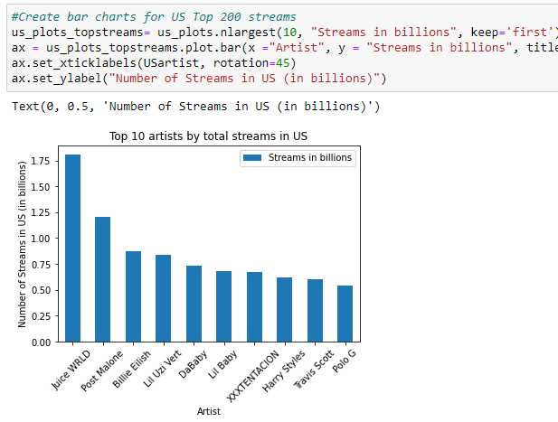
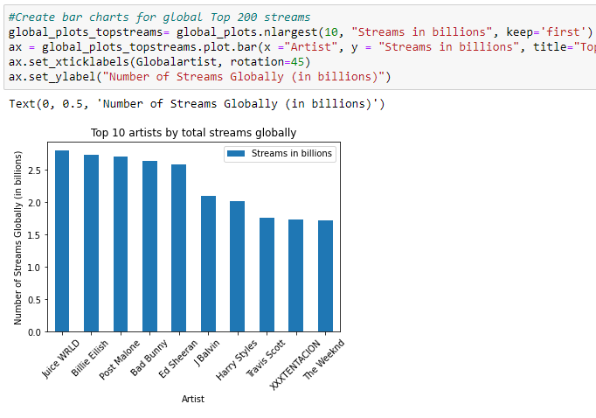
Graphs -> Top 10 total streams by artist, in US and globally
Most popular artists by: 1) number of appearances & 2) total streams in the Spotify Top 200 in the US and globally over the past year (11/2019 - 11/2020)?

Slide 18
Question:
How many of the Top 200 songs occur on both the U.S. and Global Charts?
There are 829 songs that are common to both charts, comprising 64% of the US chart and 73% of the Global chart.
Although songs common to both charts account for a smaller portion of the US chart than the global, they account for a larger portion of the streams.
Common songs appear to fall into three types:
High correlation of weeks on chart
No correlation
Short-lived on both charts

Slide 19
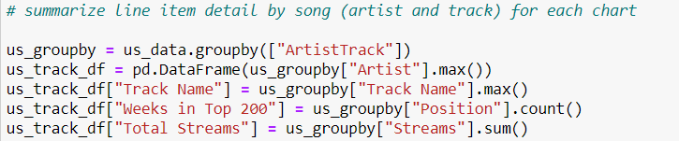
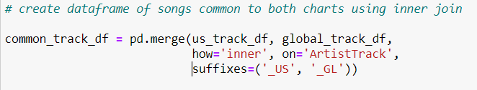
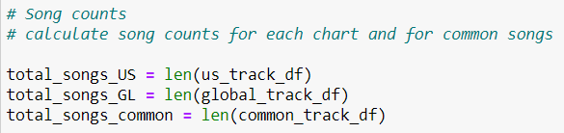
Analysis process
Summarize data by song on each chart
Do an inner join on song to identify common songs
Count the entries in the join
Not quite: artists don’t have copyright on song titles. Using song title alone overstates instances where two or more artists use the same title.

Slide 20
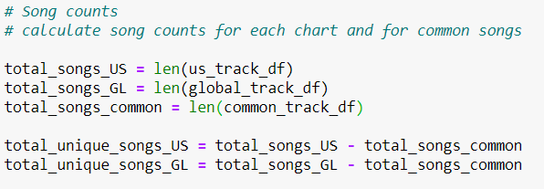
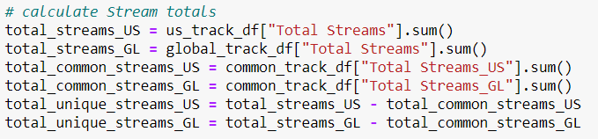
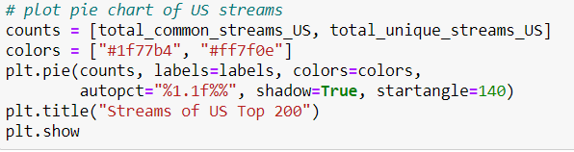
Analysis process
Extend the question: What percent of each chart do common songs/streams account for?
Calculate total songs, common songs & unique songs for each chart
Repeat for streams
Plot pie charts

Slide 21
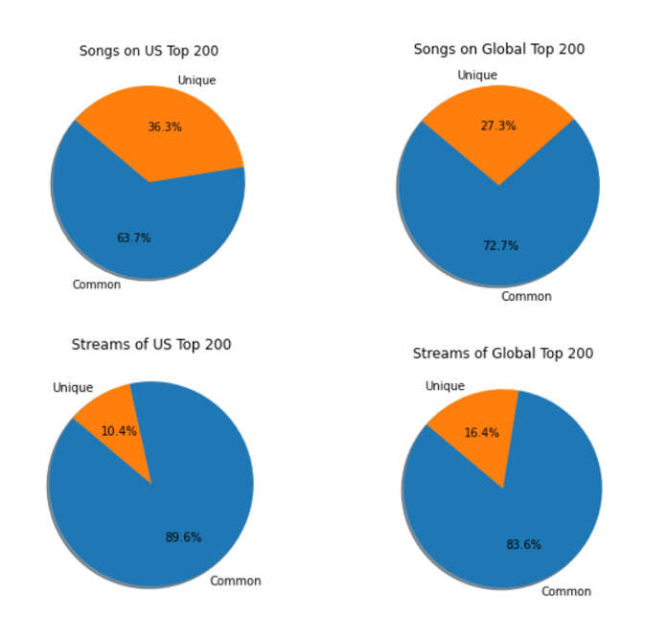
Although songs common to both charts account for a smaller portion of the US chart than the global, they account for a larger portion of the streams
US subscribers sample a broader range of songs but listen to globally popular songs more often

Slide 22
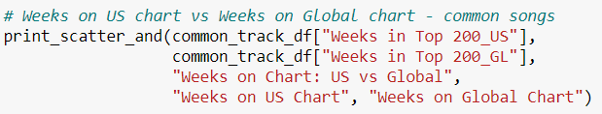
Analysis process
Extend the question: Are common songs equally popular on both charts
Count weeks on chart for common songs
Create scatter plot: Weeks on US chart vs. weeks on global chart

Slide 23
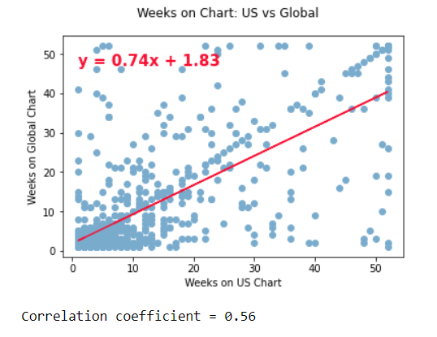
Common songs appear to fall into three types: high correlation of weeks on the chart no correlation short-lived on both charts
There appear to be factors that consistently drive popularity across both charts, and factors that are unique to each chart

Slide 24
Follow-up questions
Does the popularity on the US chart drive popularity on the global chart?
Of the songs that are common, how many are by U.S. artists vs. non-U.S.?
Why do some songs remain on both charts for the same amount of time?
What are the factors that take a song to one Top 200 chart but not the other?
Do other streaming services show similar patterns on their charts?

